Slide 1
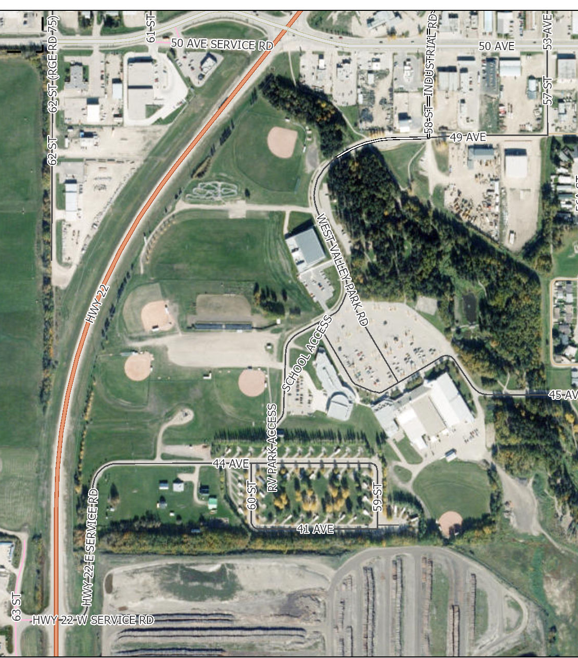
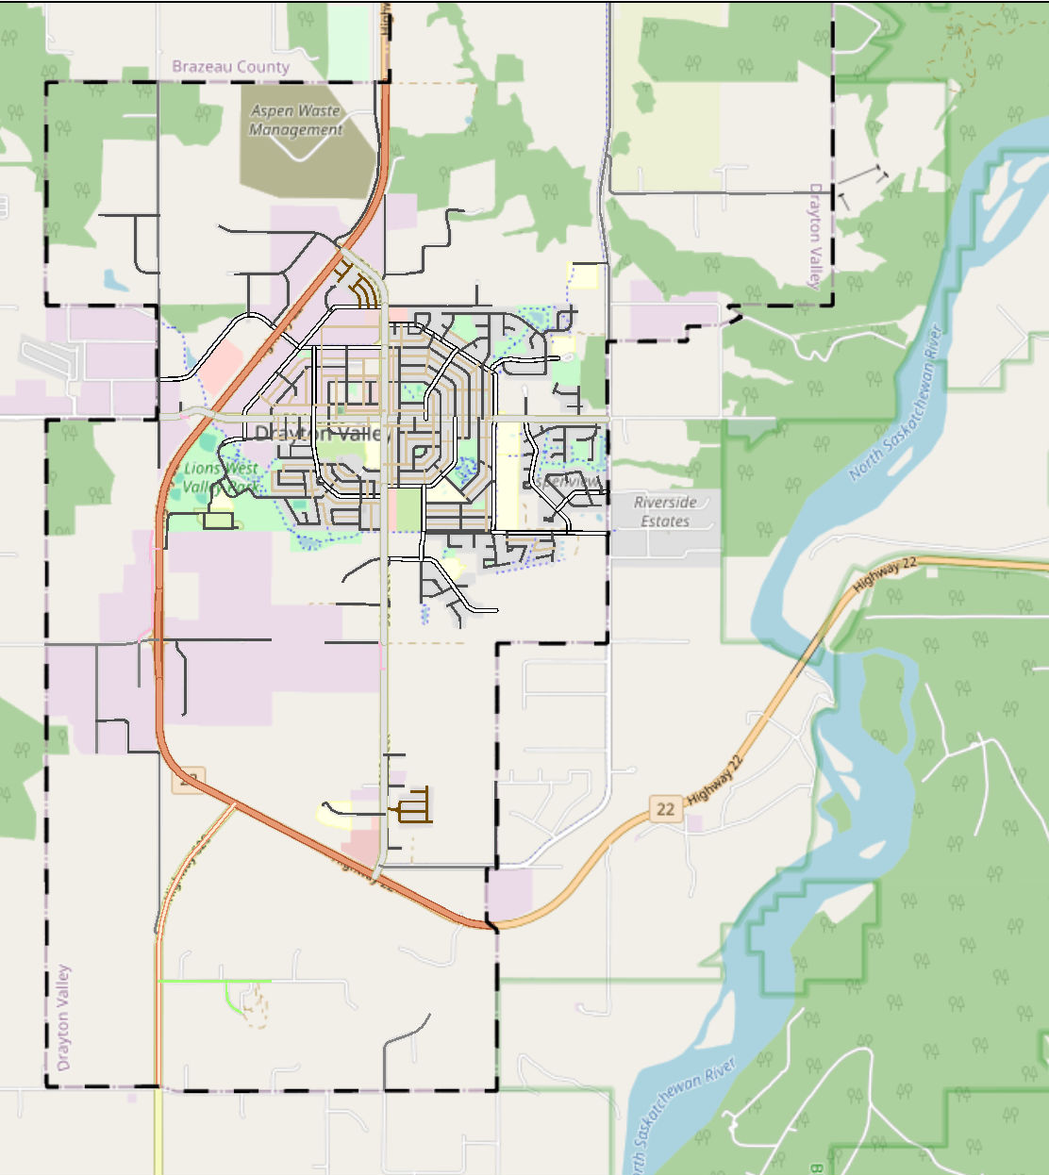
Lions West Valley Park – Drayton Valley – Diamonds 1, 3 ,4 ,5 ,19
1
1 – 18U
6– 13/11U
4 – 13U
5 – 15U
19 – 15U
Pool
6
5
Parking
4
Omniplex
19
Campground

